Slide 1
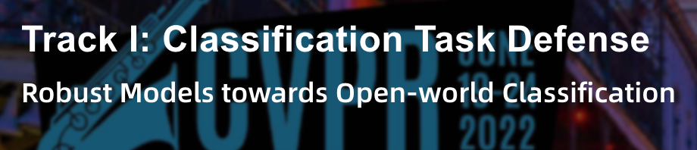
CVPR 2022 AI Safety Challenge
RobustX
Sen Pei, Jiaxi Sun, Xin Zhang, Qing Li
Institute of Automation,
Chinese Academy of Sciences

Slide 2
Outline
Background
Analysis
Our Solution
Ablation Study

Slide 3
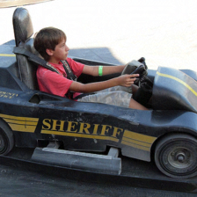


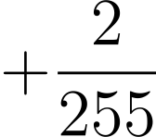

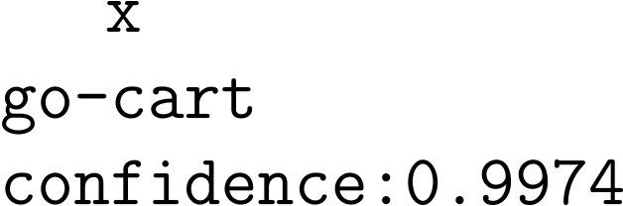
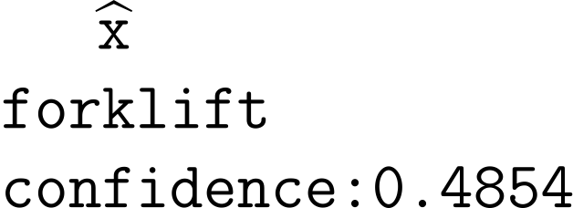
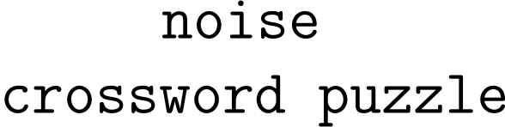
Background: Adversarial Attack
Gradient-based
The vanilla ResNet50 can be cheated easily with FGSM (Fast Gradient Sign Method)

Slide 4
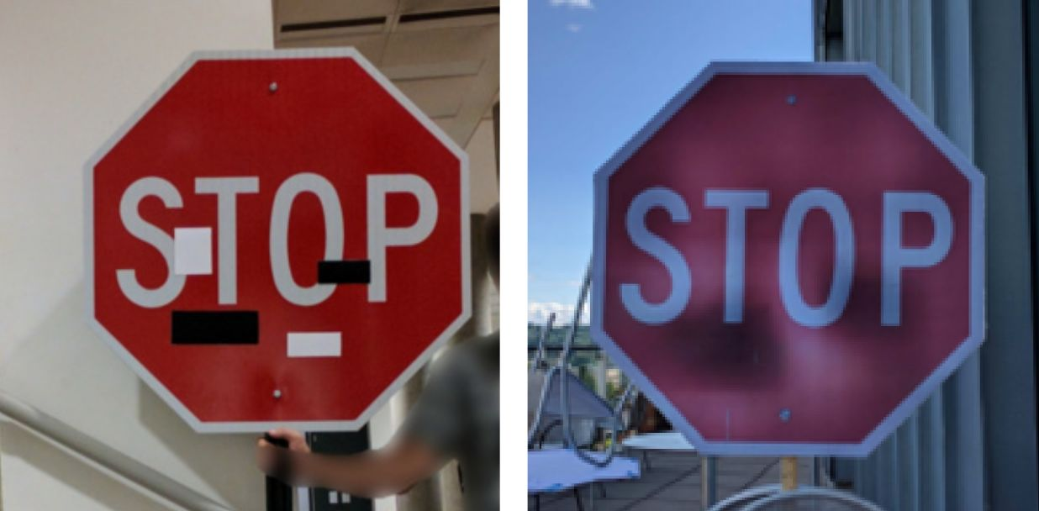
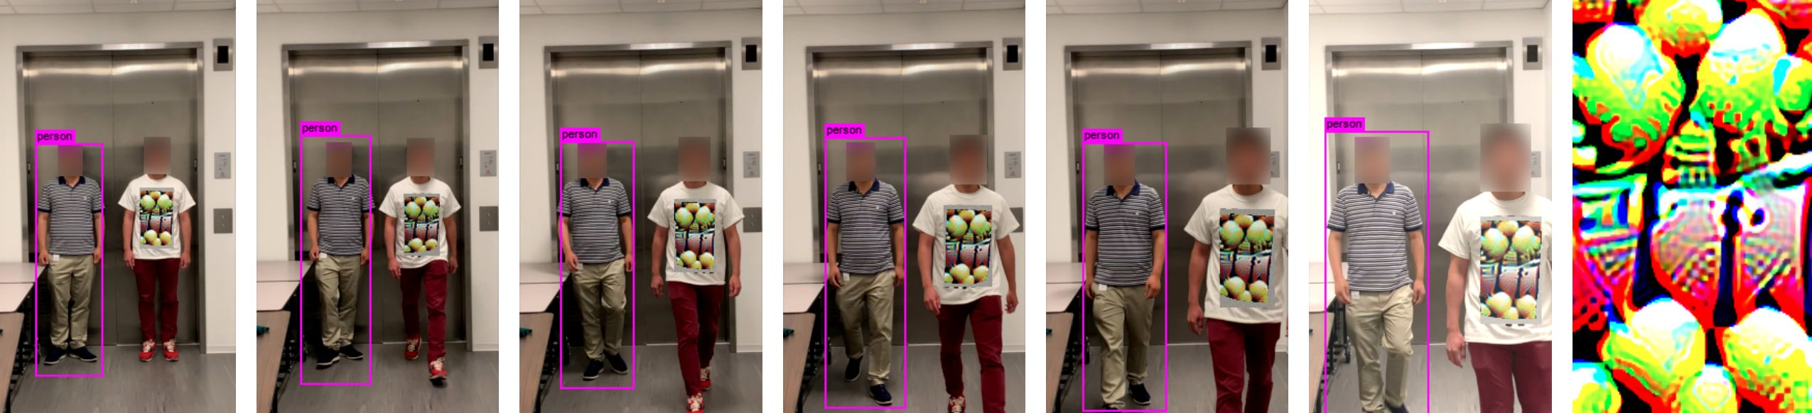
Background: AI Safety
Case 1: Automatic drive
82.6% Limitation Lifting
99.7% Limitation Lifting
Using very trivial pixel masks can make the well-trained classification model give wrong prediction, raising concern in AI Safety.
Specially designed patterns lead to failure of the monitoring system, losing the objects given in the real-time video stream.
Case 2: Monitoring scenario

Slide 5
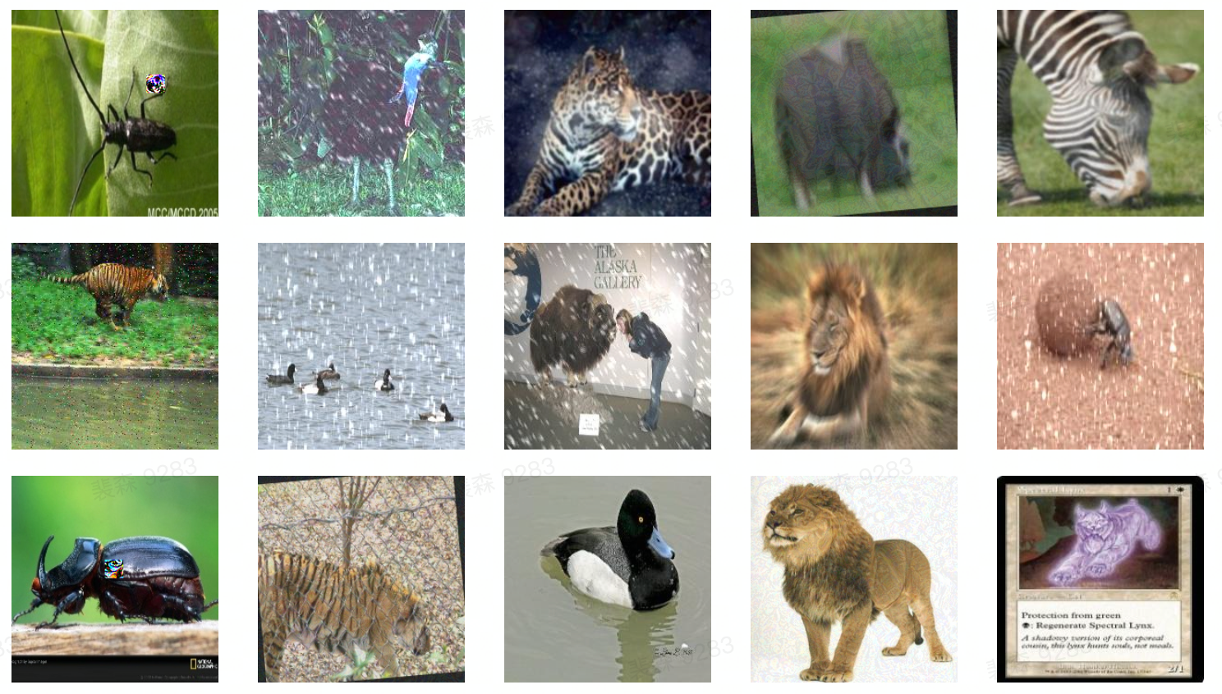
Background: Purpose
Given the aforementioned reasons, this challenge focuses on improving the robustness of models in presence of traditional noise and adversarial perturbations.

Slide 6
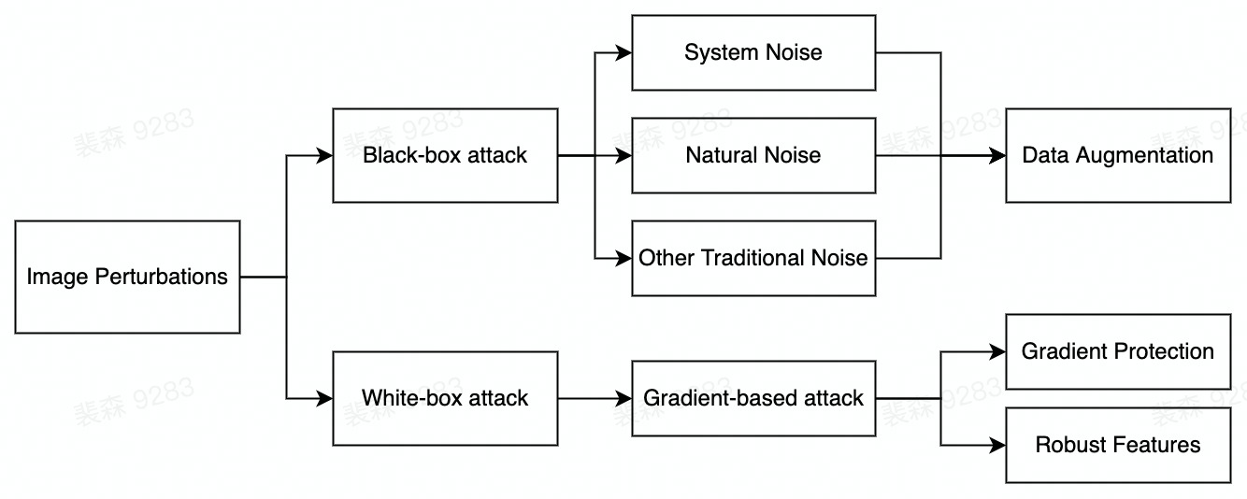

Analysis
We deal with the noise within two different manners with specially designed schemes.
In this challenge, we focus on effective data augmentation and the gradient protection.

Slide 7
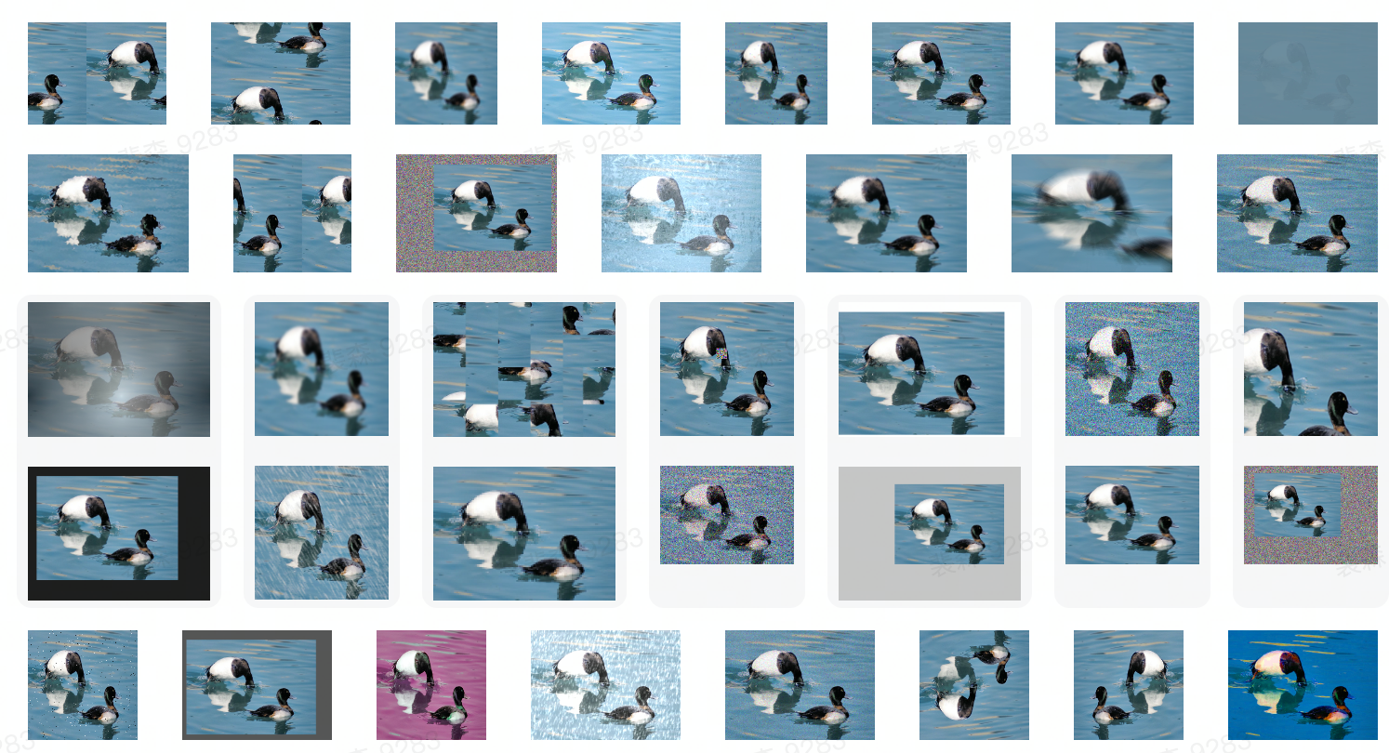
Our Solution
Specially, we detail the proposed BlockShuffle for helping capture local feature.
Data Augmentation Schemes (up to 30 kinds)

Slide 8
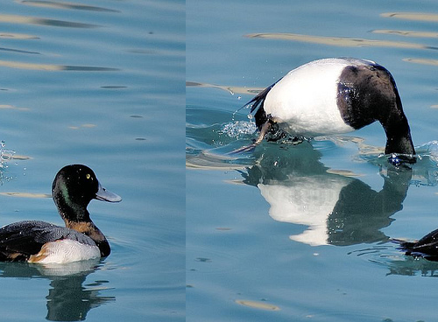
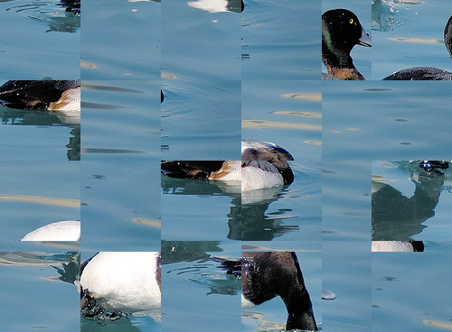
Our Solution
Data Augmentation Schemes
BlockShuffle:
Splitting the images into several patches, and then shuffle them.
Methodology:
Destroying the background and global feature, and as a result, the classifier is enforced to learn the local prominent feature.

Slide 9
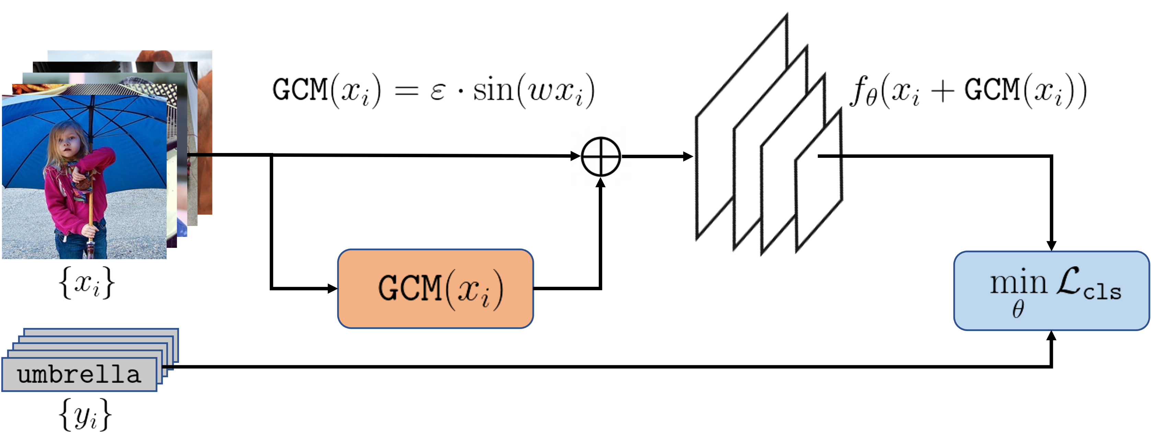
Our Solution
Gradient Protection: Gradient Concealment Module (GCM)
Impacts of GCM:
Generating output with extremely tiny magnitude given any input images.
The gradient of GCM is enormous enough to conceal the original gradient of classifier.

Slide 10
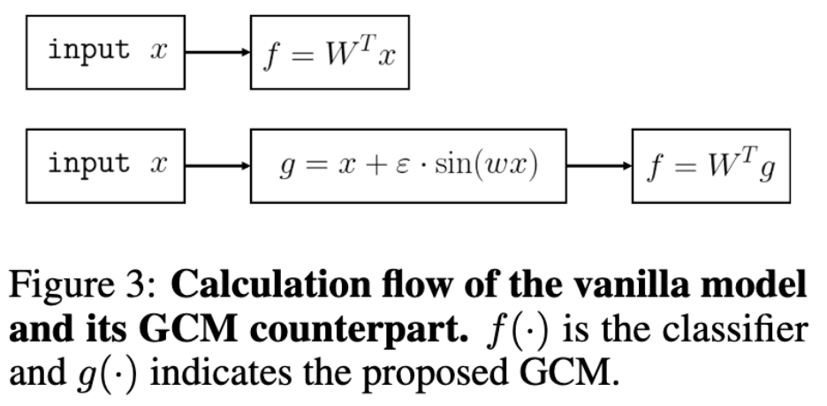
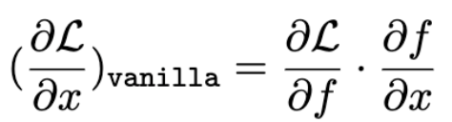

Our Solution
Gradient Protection: Gradient Concealment Module (GCM)
Methodology

Slide 11
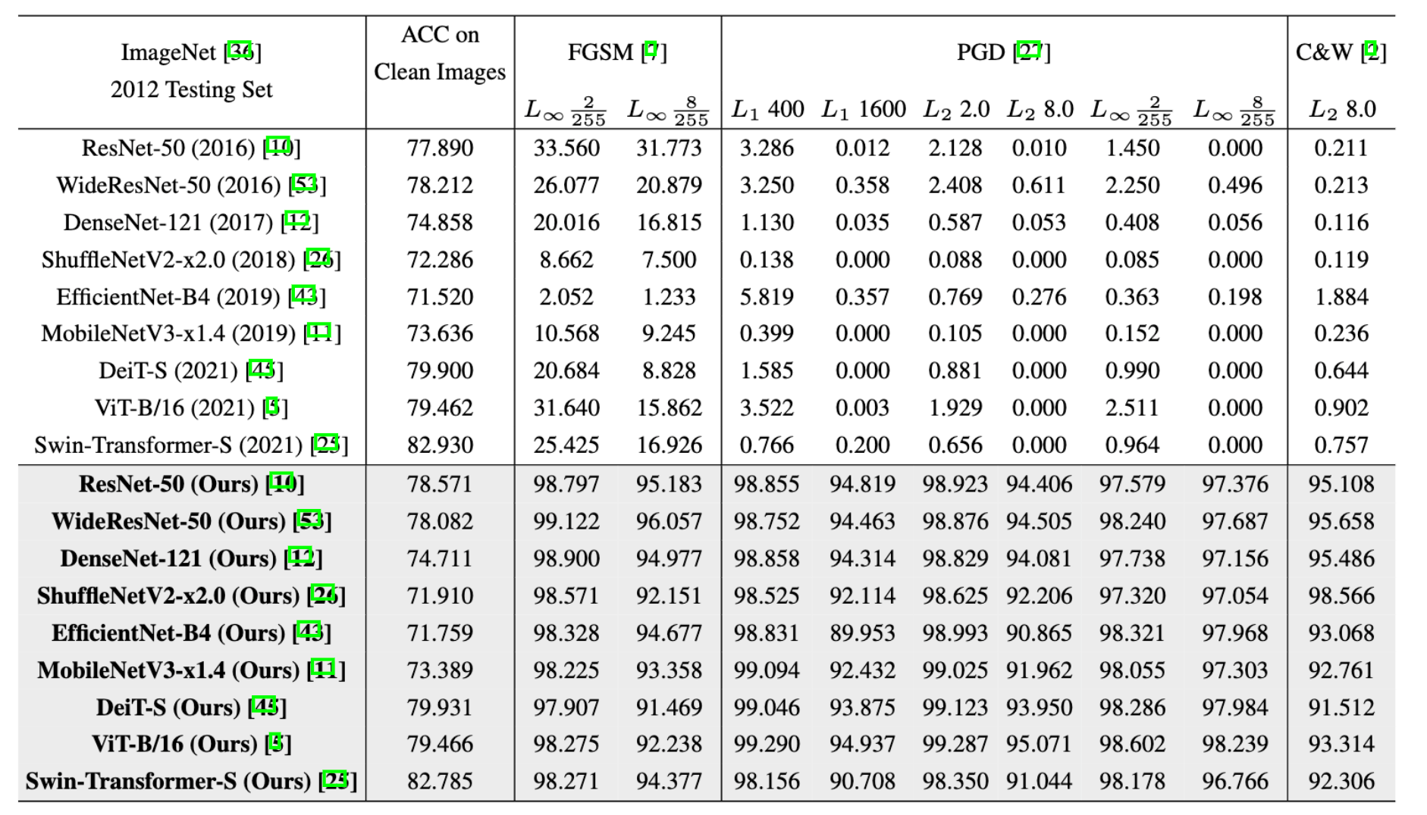
Ablation Study
We report the AR (attack robustness) metric on ImageNet 1k

Slide 12
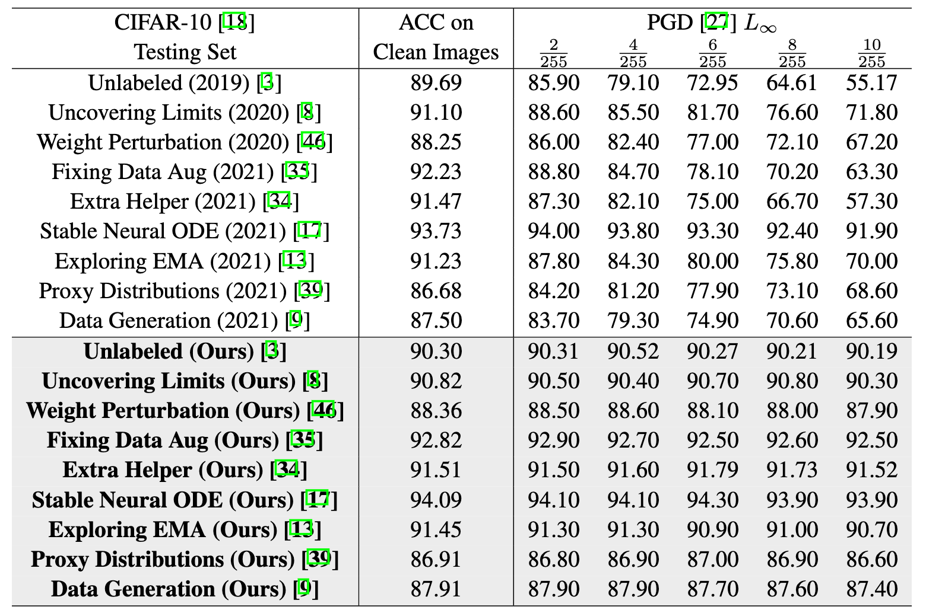
Ablation Study
We report the testing accuracy on CIFAR-10 compared to existing schemes.

Slide 13
Reference
All aforementioned methods and experimental details can be found in arXiv: 2205.10617
Source code can be found at: https://github.com/ForeverPs/Robust-Classification
Thanks !

Slide 14
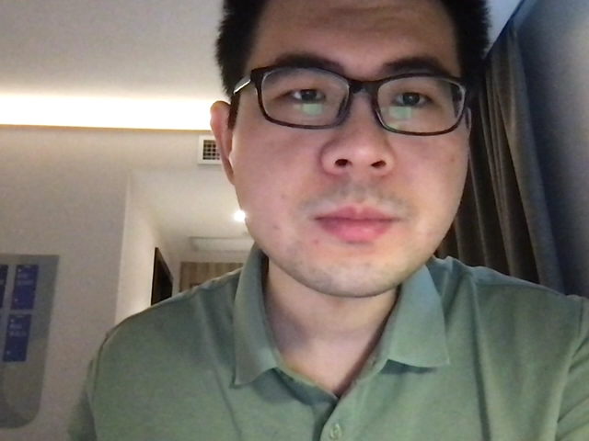
Reference
All aforementioned methods and experimental details can be found in arXiv: 2205.10617
Source code can be found at: https://github.com/ForeverPs/Robust-Classification
Thanks !

